Slide 1
Generating XML from your system
… and consuming received XML
Steve Baker
CTO, BASDA

Slide 2
Scope
XML processors
Strategies
  Application architecture
Schema validation
IRmark
  Canonicalization - c14n
  Cryptographic hashing
  Signature verification

Slide 3
General
No “best” language
  Most modern languages have good support
No “best” technique
Strategy depends on:
  Platform and tools
  Skills
  Longer-term objectives

Slide 4
Levels of processing
Keeping processing in XML
  XSLT
    Can be resource-intensive
  XPath in programs
Low-level processing
  Event-based: SAX
  Tree-based: DOM
High-level processing
  XML data binding
Notes:
XSLT, SAX and data binding are out of scope: explain why here.
XSLT does not help with integration.
SAX is too low-level for almost all applications.
XML data binding provides mechanisms for “marshalling” and “unmarshalling” between XML and objects in your own programming language. Allows the programmer to largely forget XML. Tools in fairly early stages. Recommend developers understand the other options and do the research on their own platform.

Slide 5
Processor architecture
Parser - creates “Tokens” for processing
  Eg Element start tag (or end tag)
Event Switcher
  Calls event handlers
  Often this is all that is required
Tree representation
  Events are forgotten
  Tree representation persists
  Nodes added by callbacks in event switcher
Tree processor
  Traversals usually depth-first

Slide 6
Processor architecture
DOM
SAX
Parser
(Tokens)
Your Application
Event Switcher
Event
Processing ?
Tree
Tree
Representation
Processing ?

Slide 7
DOM
Provides a tree of full-featured nodes
Platform- and language-neutral interface
Holds the whole document in memory
Programmatic access to and update of the content, structure and style of documents.
W3 standard
  Home: http://www.w3.org/DOM/
A very large specification

Slide 8
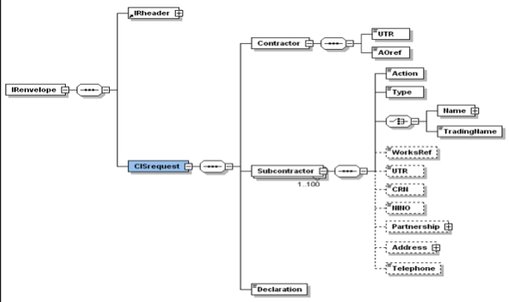
Tree of nodes

Slide 9
Strategies - consumption
Preferred method:
  Parse to a DOM tree
    Schema validation on
    Namespace aware
  Use XPath to navigate the tree
If you wish to avoid XPath
  Navigate the tree with DOM methods
Very large documents
  SAX for a lower memory consumption
Demonstration of preferred method

Slide 10
Why XML data binding?
Low-level APIs
  Require considerable code
  Give wide scope for error
  Require detailed knowledge of XML
High-level APIs
  Work with business data, not XML
In XML data binding,
  Classes hold data from XML
  Work in your own language

Slide 11
Strategies - generation
Preferred method:
  Use an abstraction (DOM) with generation tools
Could treat as text
  Print statements
  Templates
Bear in mind
  Many targets for XML data
  Transforms may be required…
Demonstration: generating XML with DOM

Slide 12
Background: digital signatures
Document
Hash
fn
Signer’s
private key
Digest
Signing
Operation
Signature
Recipient

Slide 13
Signature verification
Hash
fn
Document
Digest
Compare
Public key
operation
Signature
Digest
IRmark verification at HMRC
IRmark receipt
verification
Signer’s
public key

Slide 14
IRmark
Provides:
  Submission integrity check
  Signed digital receipt
    Proves what was received
Does not provide:
  Confidentiality
    SSL connection used
  Non-repudiation for submitter
    IRmark does not prove what was sent

Slide 15
IRmark - what you have to do
Generate IRmark
  Canonicalize XML
  Calculate a cryptographic hash
  Encode the hash in the submission
Handle failure reports from validation at HMRC
Check HMRC digital receipts and store

Slide 16
Canonicalization - c14n
Why?
  A prerequisite for hashing
What is c14n?
  XML in a (W3C) standard form
  Some examples from the specification:
    UTF-8 encoded
    Normalized line endings and attribute values
    Character and parsed entity references and CDATA sections replaced with their content
    Empty elements to start/end tag pairs
How?
  It’s easy: use a library

Slide 17
Cryptographic hashing
What is a cryptographic hash?
  A fingerprint for a document
  A cryptographic hash function:
    Maps from an input domain to an output range, where the output range is smaller than the input domain
    Collision resistant - hard to find two inputs that produce the same output
    Non-invertible - the input cannot be recovered from the output
SHA-1 is the most common hash function
  Produces a 160-bit result

Slide 18
Why c14n is needed
Equivalent XML produces different hashes
Examples using a command-line tool
  <element attr1='tree' attr2='frog' />
    sha1sum: f45a25d09e4439f734a1fc21cf05efffebeee9a9
  <element attr1="tree" attr2="frog" />
    sha1sum: 92be1e450c9cd2eacbb104a55f948bd948d97f4b
  <element attr2="frog" attr1="tree" />
    sha1sum: 0f3d9a8a5b255cc2f2a35df3c98a4deafe5b9dd5
C14n ensures that everyone calculating a checksum uses the same input

Slide 19
Encoding
Represent binary as text
In the message:
  Base64-encoded
  28 chars, A-Za-z0-9/+=
For presentation:
  Base32-encoded
  32 chars, A-Z2-7
See RFC 3548 for further details

Slide 20
The IRmark tech-pack
See:
  http://www.hmrc.gov.uk/ebu/irmark-techpack/index.htm
Contains
  Specification
  Sample IRmark code
  Schemas
  Examples
  Step-by-step guide to IRmark generation
The tech-pack example

Slide 21
Signature verification
IRmark is
  “a mechanism to aid a taxpayer to prove whether or not the submission held by IR is indeed the submission they sent.” -- IRmark specification
Packages must check the returned IRmark against that submitted
  See the dsig:DigestValue in the receipt
Packages may verify the receipt provided by HMRC
  Added reassurance of a digital signature
  The way to be sure the receipt is from HMRC
Example out of scope

Slide 22
Schema validation
Much of a program is input data checking and exception handling
XML schema can take care of much of it
Do schema-validate received XML
  Package schemas with your application
  Use an entity resolver to ensure local copies are used
See your platform documentation for details

Slide 23
Summary
Consume XML using DOM and XPath
  Schema-validate
  Namespace aware
Create XML using DOM and serializers
Generate IRmark through
  C14n
  SHA1 sum
  Encoding
Verify IRmark receipt for added assurance_x0010_

